Slide 1
Pizza Sales Analysis
Using MYSQL

Slide 2


1. Retrieve the total number to orders placed.
This MYSQL query counts the total number of orders in the ‘orders’ table based on the ‘order_id’ column.

Slide 3
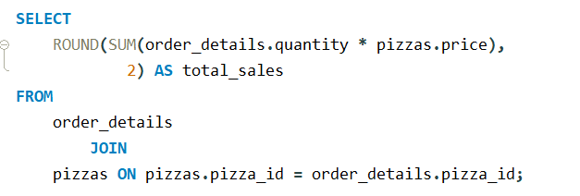

2. Calculate the total revenue generated from pizza sales.
This SQL query calculates the total sales by multiplying the quantity of pizzas ordered with their respective prices and then summing them up.

Slide 4
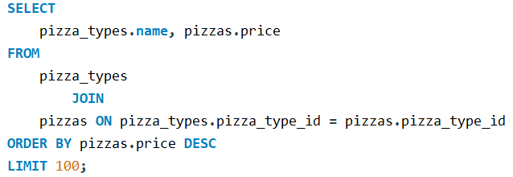
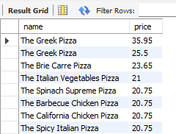
3. Identify the highest-priced pizza.
This SQL query retrieves the top 100 pizza types based on their prices, sorted in descending order.

Slide 5
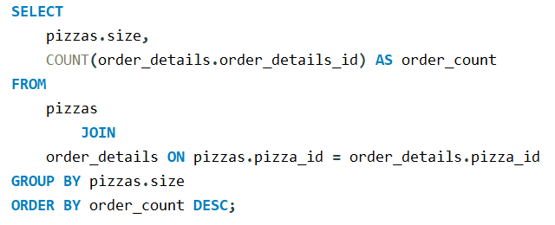
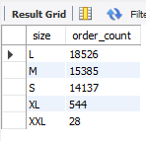
4. Identify the most common pizza size ordered.
This SQL query calculates the number of orders for each pizza size by counting the order details and grouping them by size, sorted in descending order of order count.

Slide 6
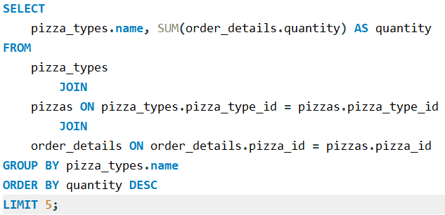
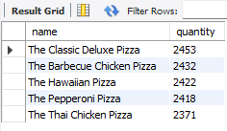
5. List the top 5 most ordered pizza types along with their quantities.
This SQL query calculates the quantity of each pizza type ordered by summing the quantities from order details and then displays the top 5 pizza types by quantity ordered.

Slide 7
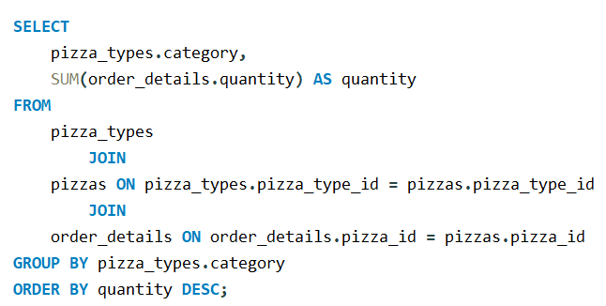
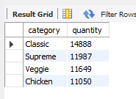
6. Join the necessary tables to find the total quantity of each pizza category ordered.
This SQL query calculates the quantity of pizzas ordered for each category and then displays the categories by quantity ordered in descending order.

Slide 8
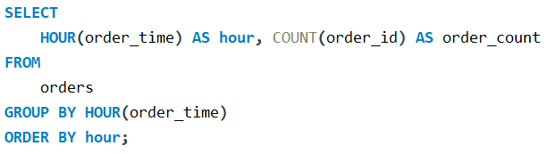
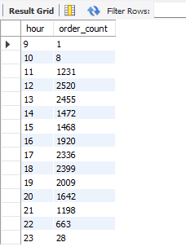
7. Determine the distribution of orders by hour of the day.
This SQL query calculates the number of orders placed for each hour of the day and presents the count of orders by hour.

Slide 9
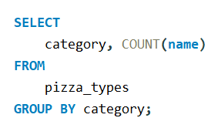
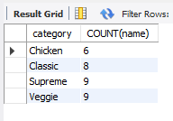
8. Join relevant tables to find the category-wise distribution of pizzas.
This SQL query calculates the number of pizza types within each category and presents the count of pizza types by category.

Slide 10
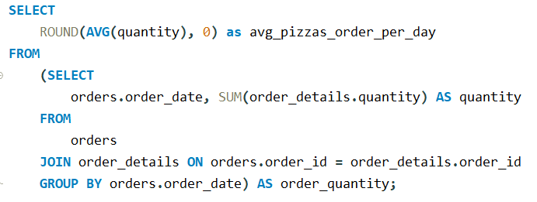

9. Group the orders by date and calculate the average number of pizzas ordered per day.
This SQL query calculates the average number of pizzas ordered per day by summing the quantities of orders per day and then averaging them.

Slide 11
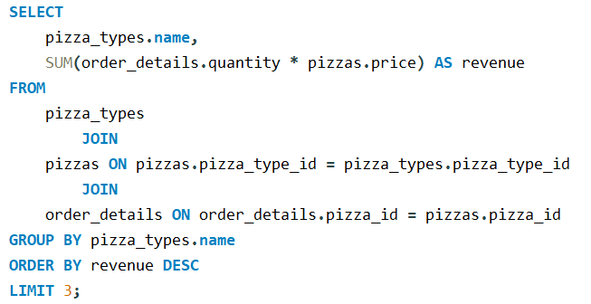
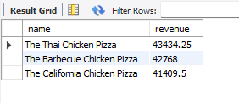
10. Determine the top 3 most ordered pizza types based on revenue.
This SQL query calculates the revenue generated by each pizza type by multiplying the quantity of pizzas ordered with their prices, and then displays the top 3 pizza types by revenue.

Slide 12
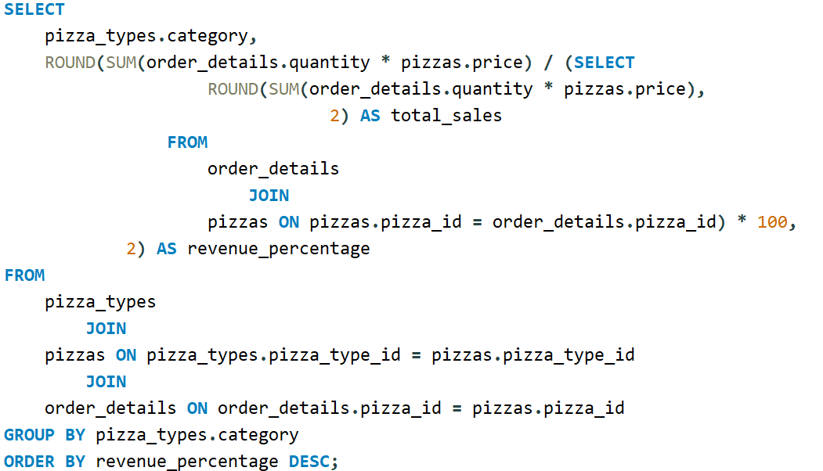

11. Calculate the percentage contribution of each pizza type to total revenue.
This SQL query calculates the revenue percentage of each pizza category by dividing the revenue generated by each category by the total sales revenue and then multiplying by 100, and then displays the results in descending order of revenue percentage.

Slide 13
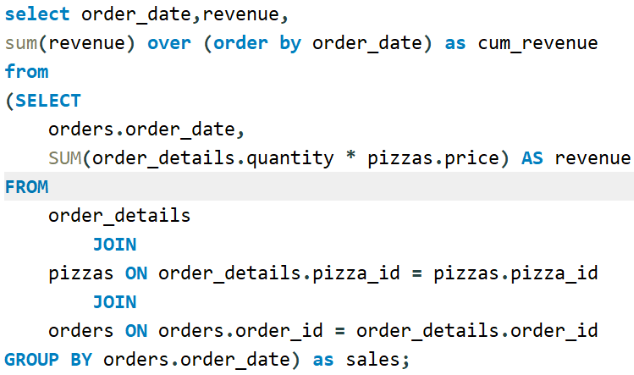
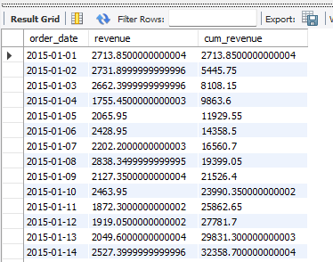
12. Analyze the cumulative revenue generated over time.
This SQL query calculates the cumulative revenue over time by summing the revenue generated for each order date and then using the window function SUM() OVER() to calculate the cumulative sum of revenue ordered by date.

Slide 14
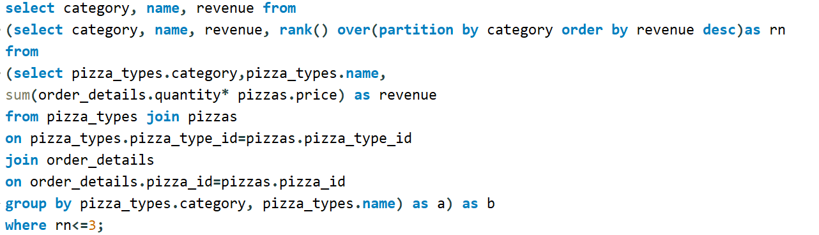
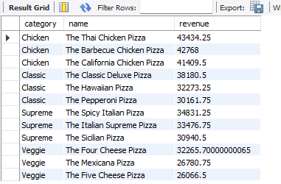
10. Determine the top 3 most ordered pizza types based on revenue for each pizza category.
This SQL query calculates the top 3 pizza types by revenue within each category by ranking the pizza types based on revenue within each category and filtering the results to only include the top 3.

